Slide 1
Public transportation and optimization
Team members:
G.Swetha
P.Nandhini
S.Manjuladevi
A.Chinnathai
Guided by:
Mrs.S.Vaitheki
Assistant proffessor
Dept of ECE

Slide 2
objectives
By establishing a multi objective public transportation dispatching optimization model , starting from bus companies , passengers and govt department , public transportation operation costs comprehensively consider the interests of various parties and finally realize the optimization objective of minimizing fixed costs
We using the smart transportation system to optimizing the public transport

Slide 3
Using smart transportation
“Intelligent Transportation Systems (ITS) apply a variety of technologies to monitor, evaluate, and manage transportation systems to enhance efficiency and safety.” Putting visions of science fiction style transportation aside for the moment, this definition can be simplified into the following concepts for what makes up smart transportation: management, efficiency, and safety.

Slide 4
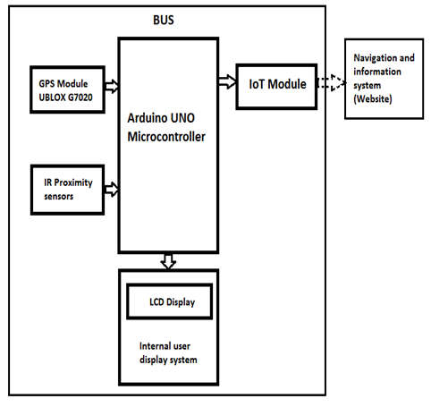
Block digram

Slide 5
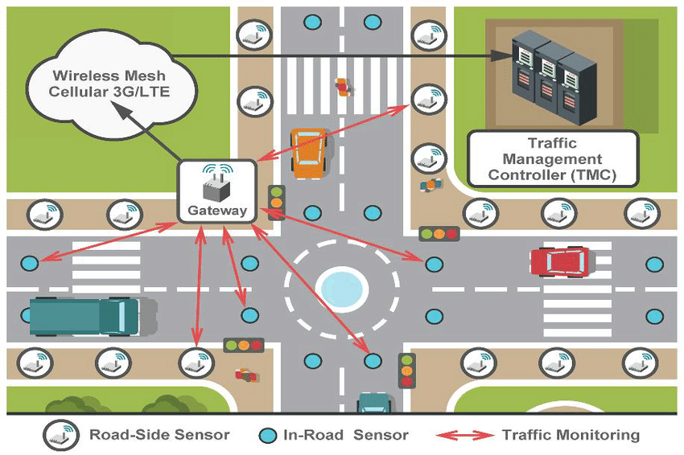
Using iot

Slide 6
Smart transportation
Introduction:
Smart transportation is not just a theory for the future; it is being implemented today in several cities with their successes and failures being used to improve systems in new locations. Some of the cities that are implementing new transportation technologies may surprise you at first. Of course, global hubs like New York City have embraced smart transportation for their ever increasingly intelligent city. However, the rural state of Wyoming is also a leading testbed for connected vehicles. This is because the cowboy state is a major freight corridor — autonomous transportation of goods across the country can drastically improve supply chain efficiency and reduce the need for long-haul drivers forced to balance tight timelines with their human need for rest.

Slide 7
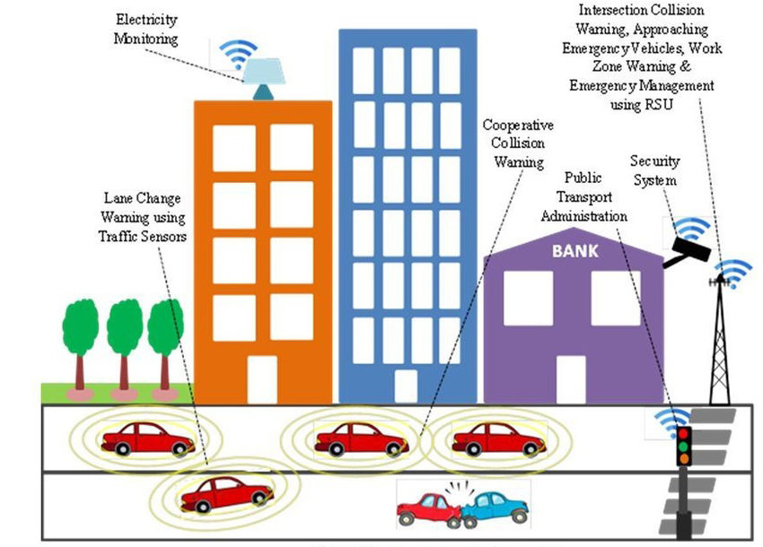
Using iot

